Slide 1

Student Details
Name : KAMANU LAKSHMAN
Skill IDbuild email : 20ne1a0110@gmail.com
College name : TIRUMALA ENGINEERING COLLEGE
College state : ANDHRA PRADESH
Internship domain : ARTIFICAL INTELLIGENCE
Start date-end date : 05/06/2023 -15/07/2023

Slide 2
EMPLOYEES BURNOUT ANALYSIS
AND
PREDICTION

Slide 3
PROJECT TITTLE :- EMPLOYEES BURNOUT ANALYSIS AND PREDICTION PROBLEM STATEMENT:- The objective of this day is to raise awareness about mental health issues around the world and mobilize efforts in support of mental health. According to an anonymous survey, about 450 million people live with mental disorders that can be one of the primary causes of poor health and disability worldwide. These days when the world is suffering from a pandemic situation, it becomes really hard to maintain mental fitness.

Slide 4
AGENDA
Research shows that in today’s network-centric, knowledge-centric and collaborative enterprise, employee burnout is the biggest threat to building an engaged workforce. Employee disengagement has a huge impact on productivity and overall business success. Preventing employee burnout has become a priority for business and human resource leaders. However, identifying at-risk employees has always been difficult because traditional HR data, which can be subjective and often out of date, is of limited value in predicting employee burnout.

Slide 5
PROJECT OVERVIEW
Burnout is a mental state caused by excessive stress that results in emotional instability and a reduction in an individual’s performance capacity. Burnout is defined as, among other things, a fear of failure, a sense of powerlessness, and a sense of performance pressure. It has more to do with dealing with one’s conscience than with dealing with society. Tiredness, a lack of sleep, a lack of inspiration and productivity, concentration issues, frequent headaches, and other factors all contribute to burnout. Burnout isn’t just a problem for people in the business world; it can affect anyone, including students, stay-at-home moms, teachers, and others. Many people are affected by this, and they are unaware that they are “burned out,” therefore the symptoms go untreated, which can be problematic in the long term. It is possible to create a model that allows people to assess themselves using a curated set of criteria (factors) and estimate the rate of burnout. This paper gives an overview of various regression models offered in the existing literature for predicting employee burnout, and the best performing model is selected through a comparison based on different evaluation techniques.

Slide 6
YOUR SOLUTION AND ITS VALUE PROPOSITION
The system consists of both hardware and software in order to accurately track the time and attendance . Employees simply clock in or clock out from shifts using digital authentication methods, such as an ID card or password. Then, time data is automatically synced with back-end software, payroll systems, and more.

Slide 7
WHO ARE THE END USERS of this project?
AI can understand what kind of behavior is normal and what’s out of the ordinary. If an employee that is usually very efficient with their time suddenly becomes slow and unproductive in their work, it’s a red flag that they’re getting burnt out and need a break. HR can use the data collected by AI as evidence for telling employees why they need vacation. Workers are often hesitant to take much-needed time off. But now companies can have solid evidence as to why it’s necessary. Upon returning from a short work leave, employees tend to have more motivation, a better attitude, improved focus. And overall, they are more effective, efficient and proactive in the work that they do.
AI Solutions
HR Challenges

Slide 8
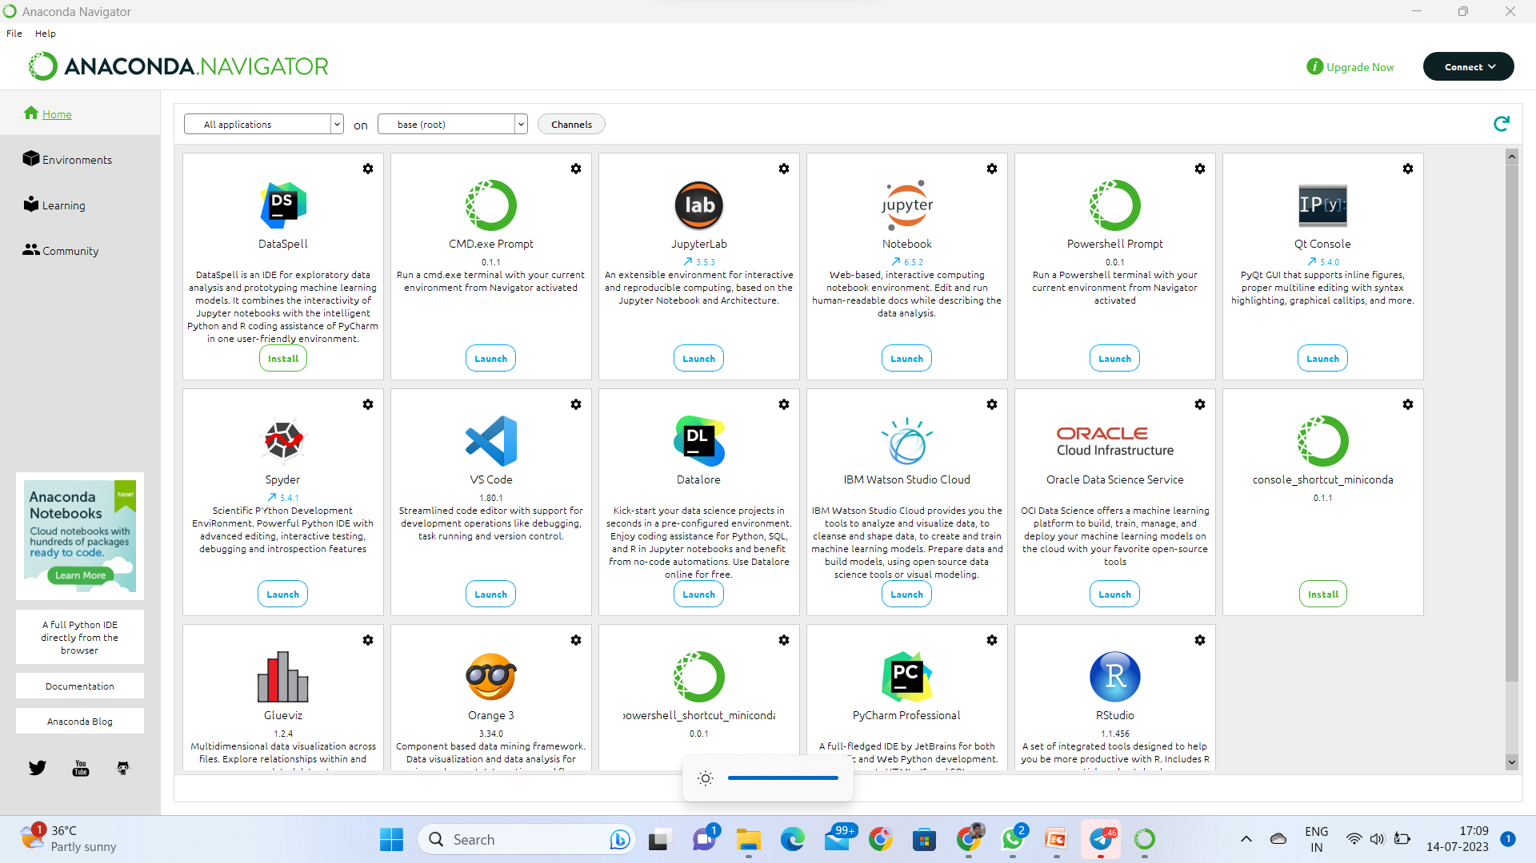
Installation of Anaconda Navigator
Open Google Chrome in system.
Type “Anaconda” in the search bar and press Enter.
Click on first link in anaconda navigator.
Select Windows if your system is windows 64-bit / Linux / Mac.
After download go to file manager and click on it.
Click on Next, Next , Next .
Wait for sometime.
The Anaconda Navigator will be installed.
After installation in windows search bar type “Anaconda Navigator “. Press enter
The page will be open .

Slide 9
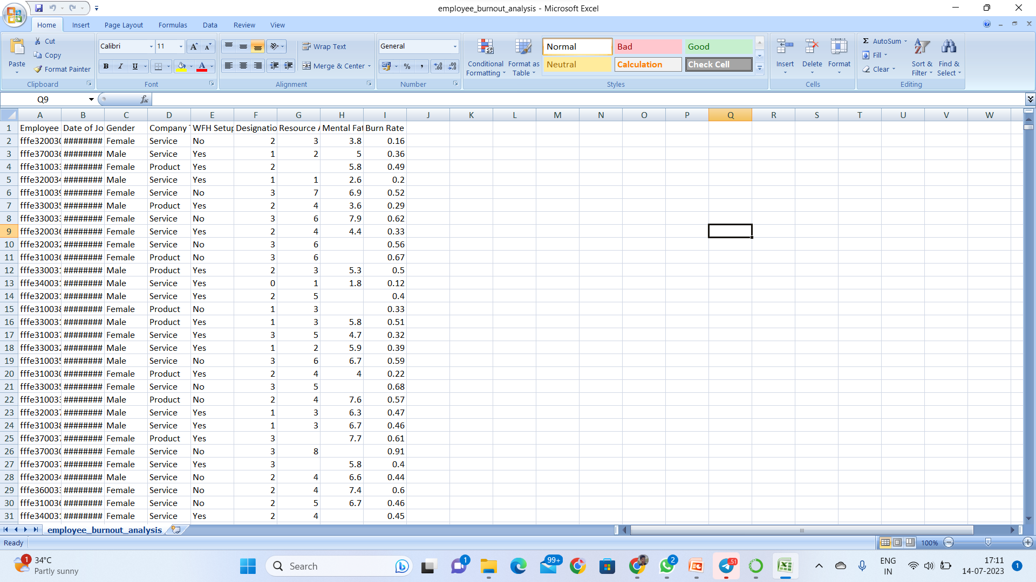
Dataset of Employees burnout analysis and prediction
/content/employee_burnout_analysis.c/content/employee_burnout_analysis.csv

Slide 10
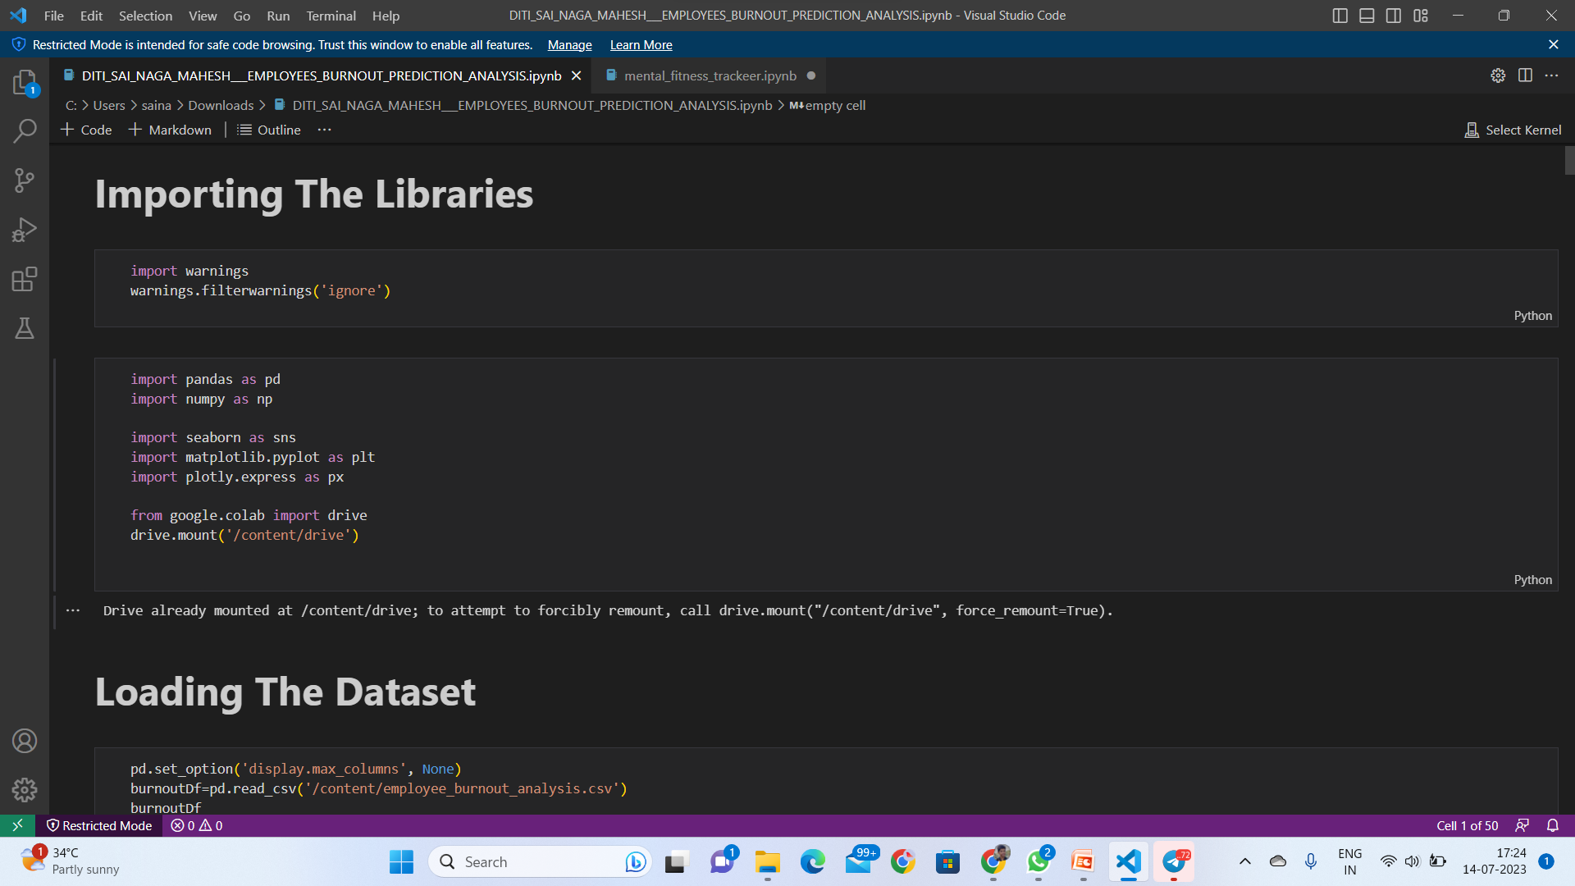
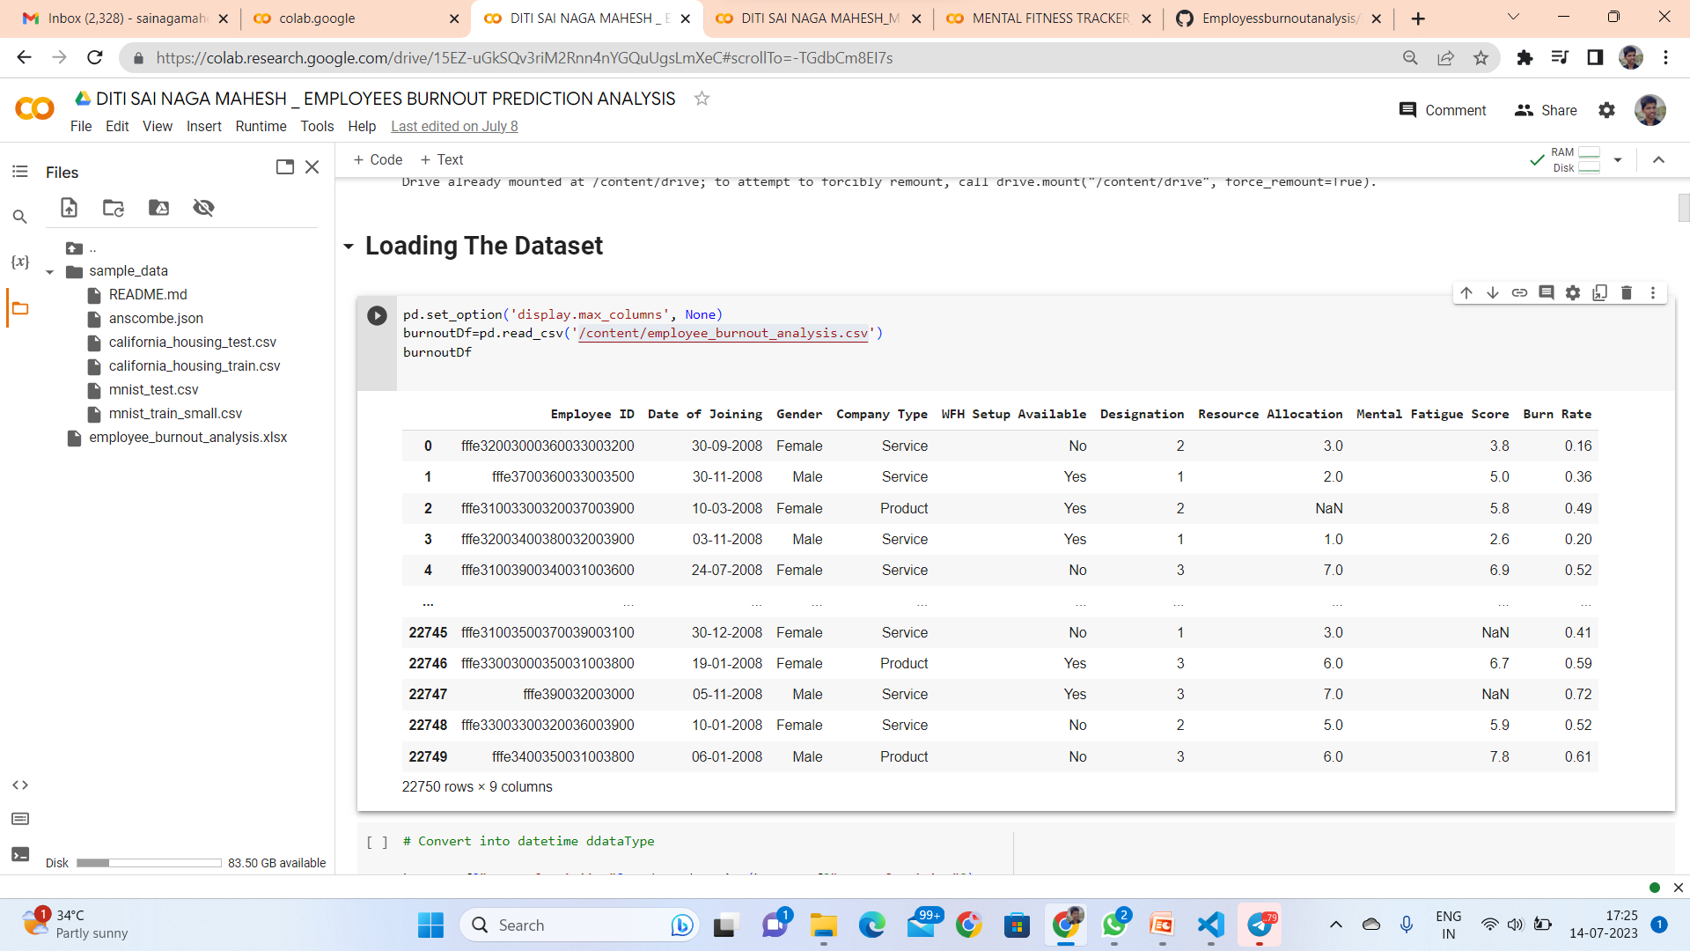
How did you customize the project and make it your own

Slide 11
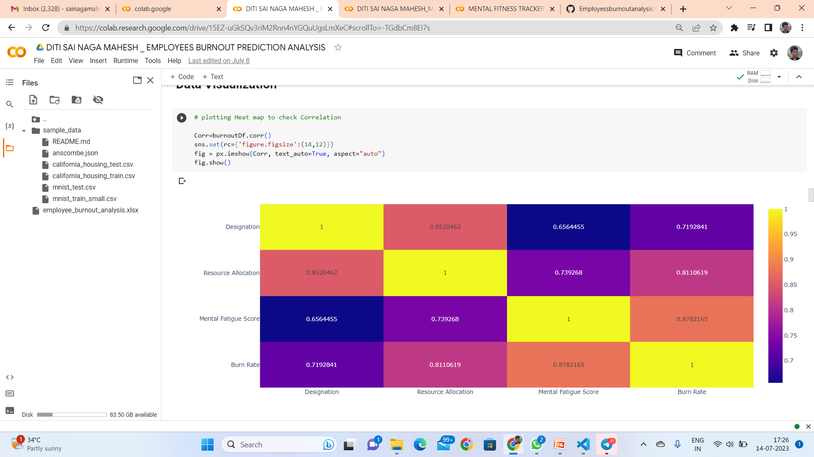
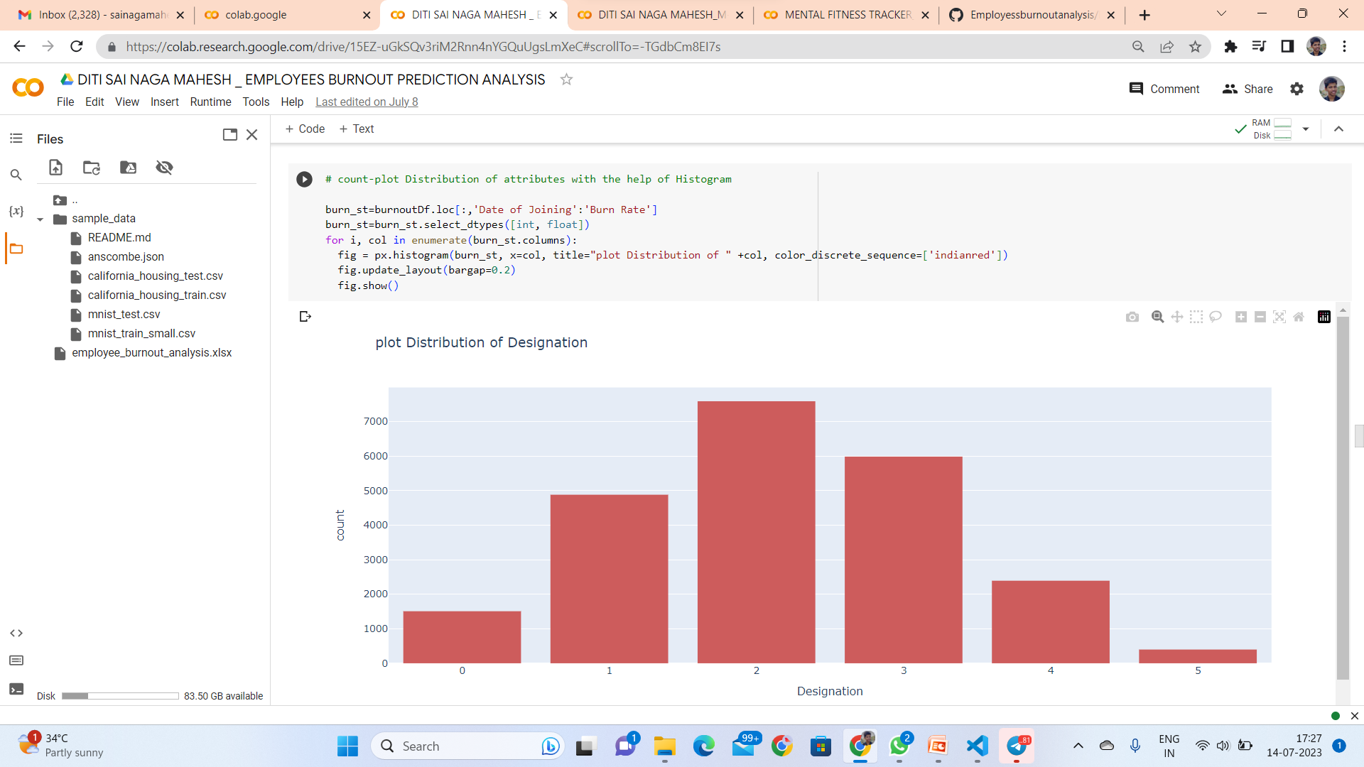
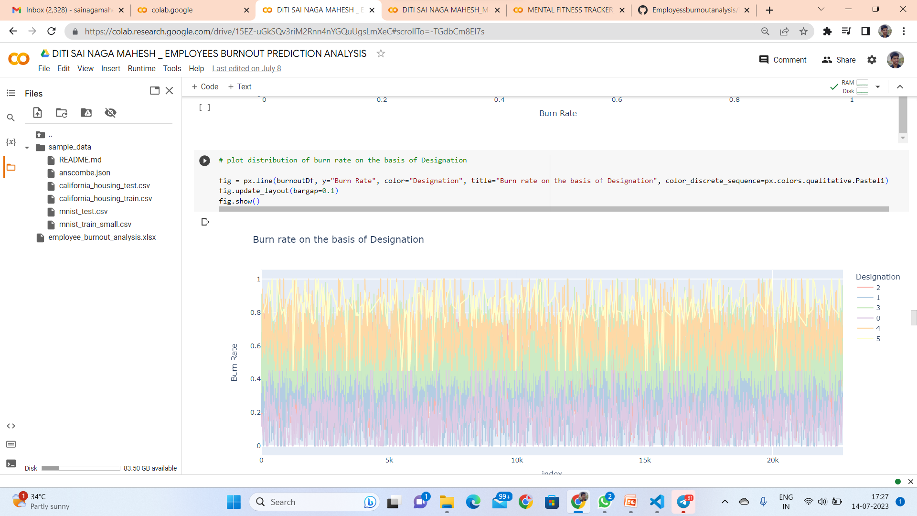
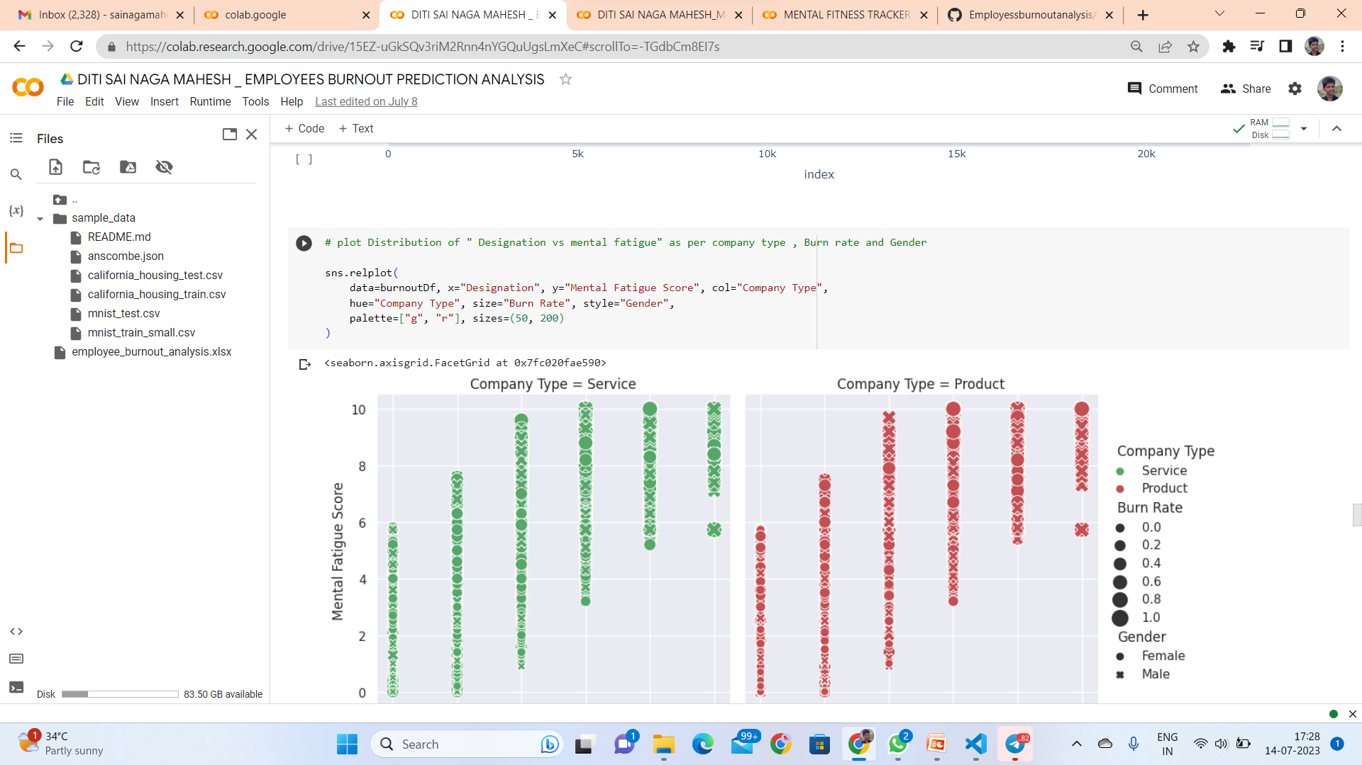

Slide 12
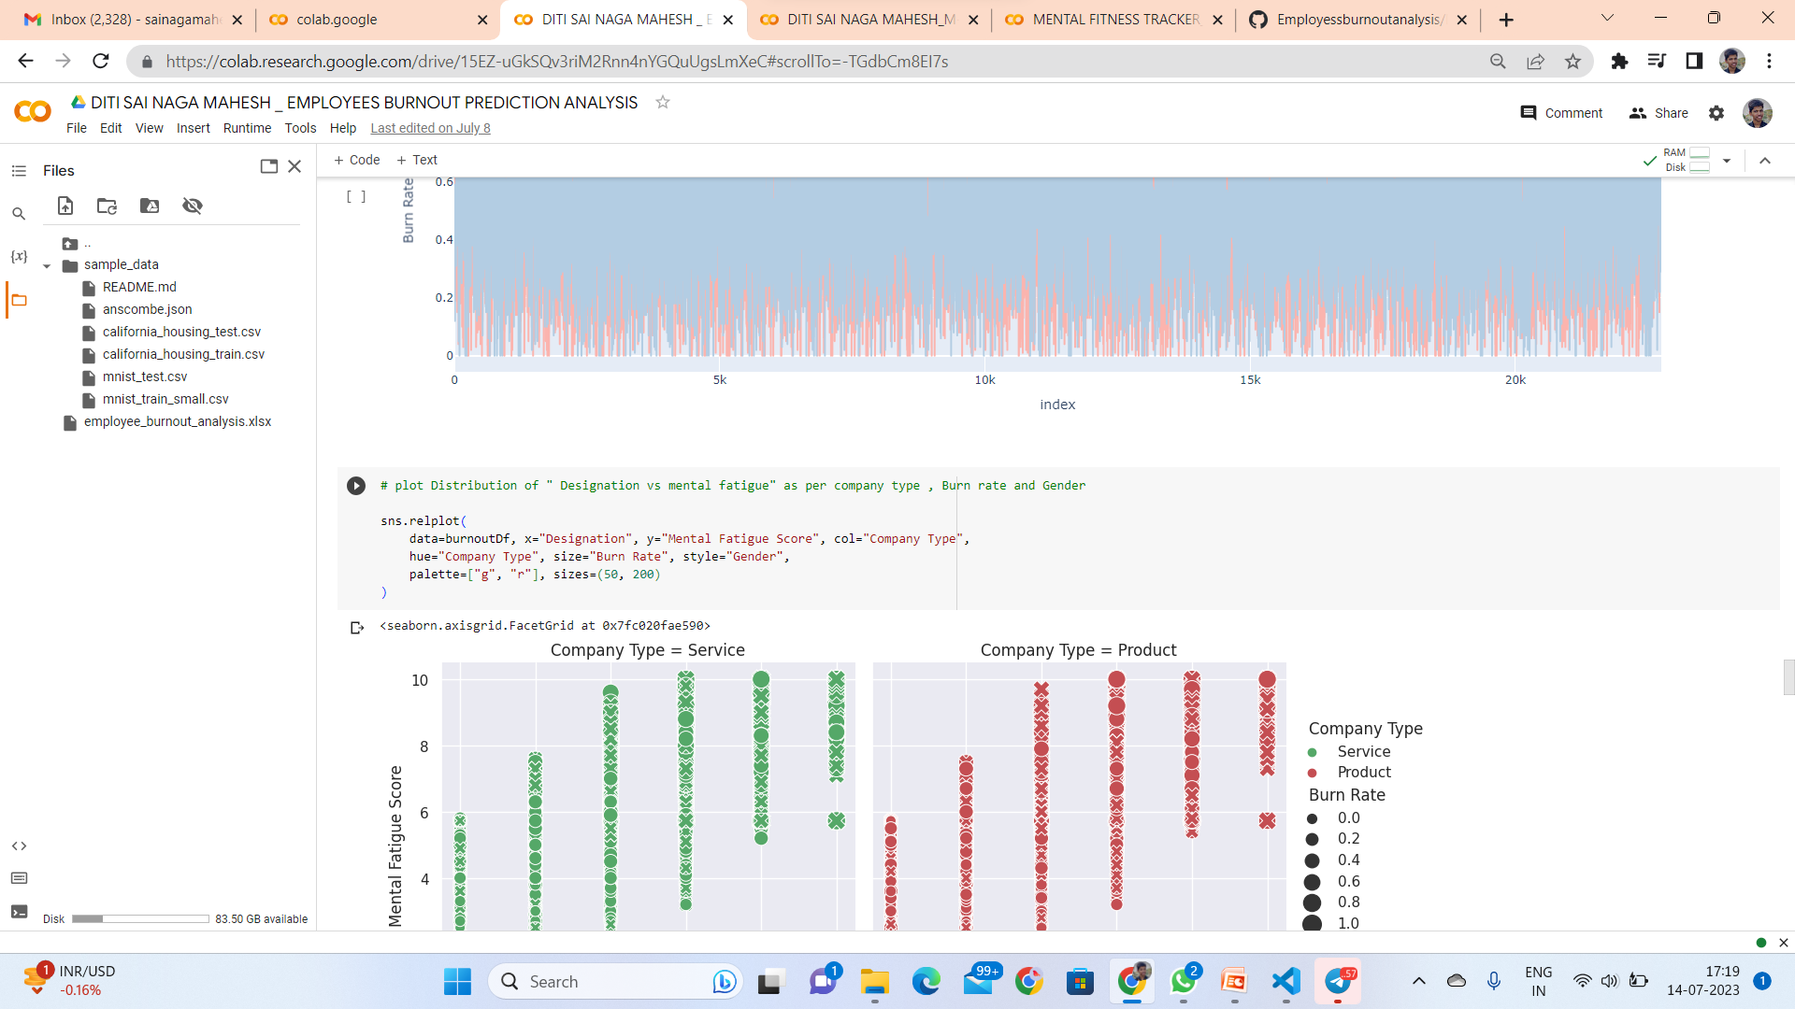
Modelling

Slide 13
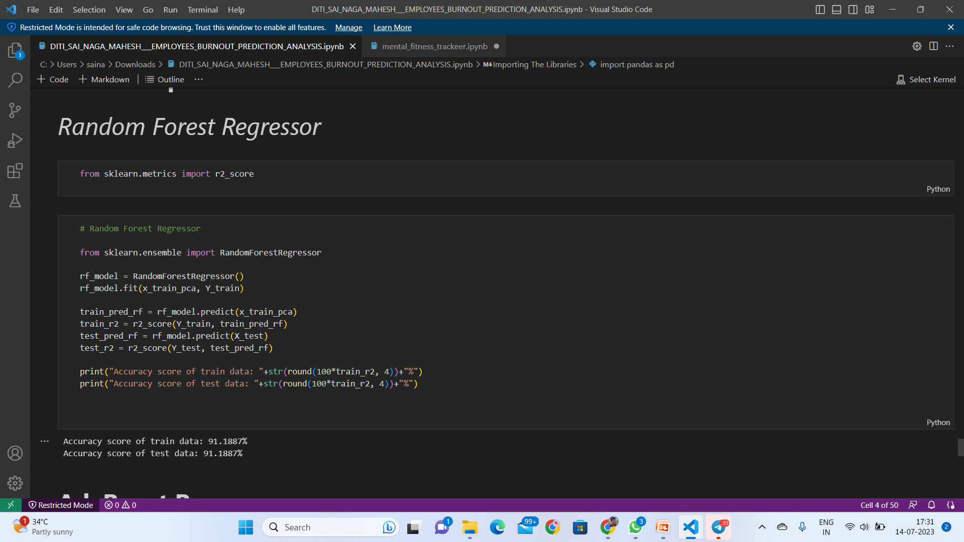
Results Random Forest Regressor

Slide 14
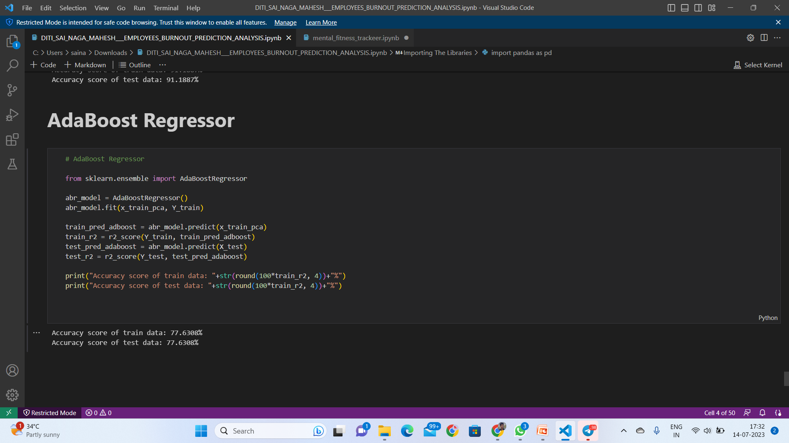
Results Ada Boost Regressor

Slide 15
links
Github link :-
https://github.com/Ramya-477/Employee-Burnout-Analysis-and-prediction.git

Slide 16


